Slide 1
Lecture 07 Transport Layer
Penjelasan
TCP ACK generation [RFC 1122, RFC 2581]
CSI3601504 - Jaringan Komunikasi Data
Semester Gasal 2015-2016
Fakultas Ilmu Komputer UI

Slide 2
TCP ACK generation [RFC 1122, RFC 2581]
event at receiver
arrival of in-order segment with
expected seq #. All data up to
expected seq # already ACKed
arrival of in-order segment with
expected seq #. One other
segment has ACK pending
arrival of out-of-order segment
higher-than-expect seq. # .
Gap detected
arrival of segment that
partially or completely fills gap
TCP receiver action
delayed ACK. Wait up to 500ms
for next segment. If no next segment,
send ACK
immediately send single cumulative
ACK, ACKing both in-order segments
immediately send duplicate ACK,
indicating seq. # of next expected byte
immediate send ACK, provided that
segment starts at lower end of gap
RULE 1
RULE 2
RULE 3
RULE 4

Slide 3
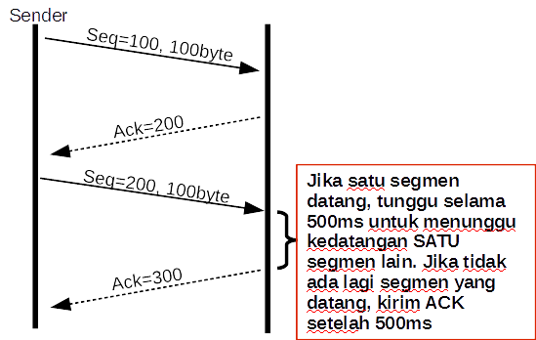
TCP ACK generation [RFC 1122, RFC 2581]
event at receiver
arrival of in-order segment with
expected seq #. All data up to
expected seq # already ACKed
TCP receiver action
delayed ACK. Wait up to 500ms
for next segment. If no next segment,
send ACK
RULE 1

Slide 4
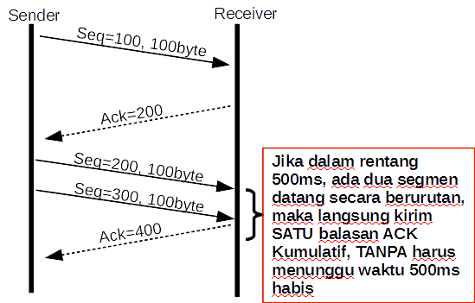
TCP ACK generation [RFC 1122, RFC 2581]
event at receiver
arrival of in-order segment with
expected seq #. One other
segment has ACK pending
TCP receiver action
immediately send single cumulative
ACK, ACKing both in-order segments
RULE 2

Slide 5
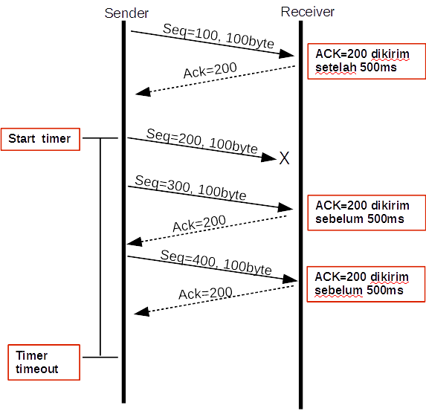
TCP ACK generation [RFC 1122, RFC 2581]
event at receiver
arrival of out-of-order segment
higher-than-expect seq. # .
Gap detected
TCP receiver action
immediately send duplicate ACK,
indicating seq. # of next expected byte
RULE 3

Slide 6
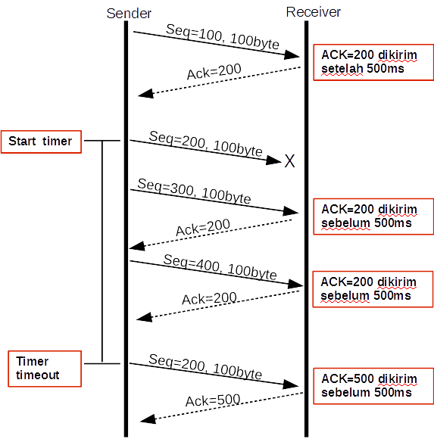
TCP ACK generation [RFC 1122, RFC 2581]
event at receiver
arrival of segment that
partially or completely fills gap
TCP receiver action
immediate send ACK, provided that
segment starts at lower end of gap
RULE 4

